Slide 1
BITS Pilani
Dr.Aruna Malapati
Asst Professor
Department of CSIS

Slide 2
IBM Model-2

Slide 3
Today’s Agenda
Understand the model building in IBM Model 2 in machine translation

Slide 4
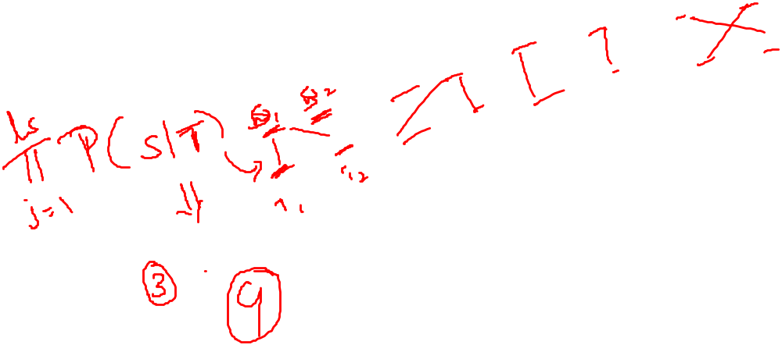

Slide 5
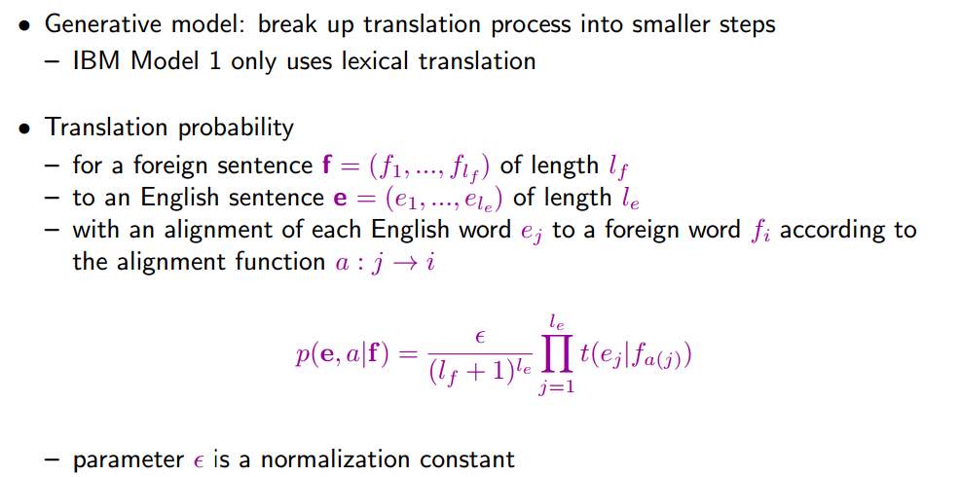
Reminder: IBM Model 1

Slide 6
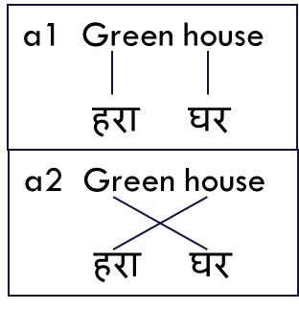
Drawbacks in IBM model -1
According to IBM Model 1 the translation probabilities for the following two alternative translations are the same:

Slide 7

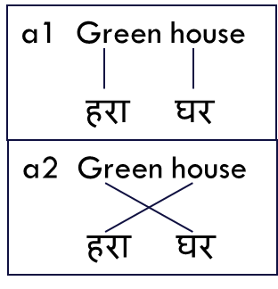
IBM Model - 2
In IBM Model 2, we add an explicit model for alignment.
In IBM Model 1 the following alignments a1 and a2 are treated equal. But some alignments are more likely than the others.
IBM Model 2 addresses the issue of alignment with an explicit model for alignment based on the positions of the input and output words.

Slide 8


IBM Model - 2
Translating source word at position i to target word at position j is modeled by an alignment probability distribution
a(i | j, l_{e}, l_{f} )
We can view translation under IBM Model 2 as a two-step process
1 2 3 4
वह घर सुंदर है
Lexical Translation
modeled as t(e| f )
that house beautiful is
alignment step
that house is beautiful
1 2 3 4
Notes:
The alignment probability distribution a(i|j,le,lf) models the probability of a word in the position i in the source sentence of being reordered into the position j in the target sentence.

Slide 9
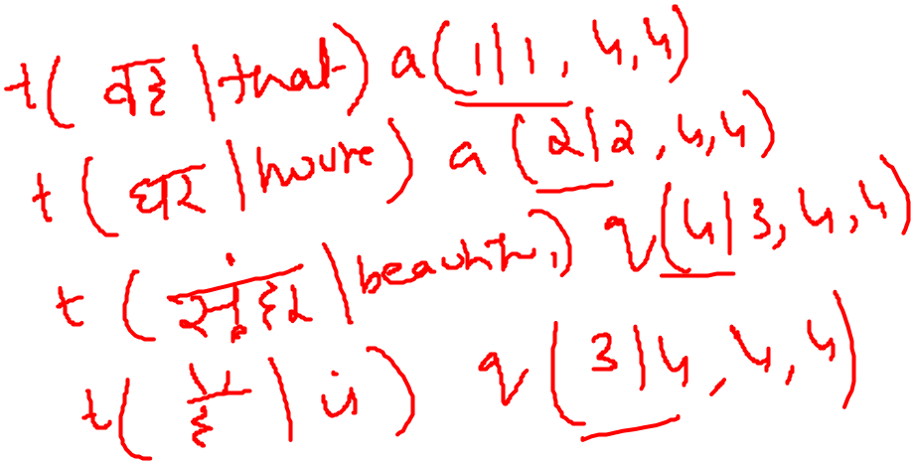
IBM Model - 2
1 2 3 4
वह घर सुंदर है
Lexical Translation
modeled as t(e| f )
that house beautiful is
alignment step
that house is beautiful
1 2 3 4
For instance, translating है into is has a lexical translation probability of t(is|है)
and an alignment probability of a(4|3, 4, 4) – the 3rd English word is aligned to the 4th foreign word.
Note that the alignment function a maps each English output word j to a foreign input position a(j) and the alignment probability distribution is also set up in this reverse direction.

Slide 10

IBM Model - 2
The two steps are combined mathematically to form IBM Model 2:
The final form the model is going to be the joint probability of e and a conditioned on f

Slide 11
Example
1 2 3 4
l_{e},l_{f}=3
The probability of this alignment is a=(1,2,4,3)
a(1|1,4,4) t(that| वह ) X
a(2|2,4,4) X
a(4|3,4,4) X
a(3|4,4,4)
वह घर सुंदर है
Lexical Translation
modeled as t(e| f )
that house beautiful is
alignment step
that house is beautiful
1 2 3 4

Slide 12
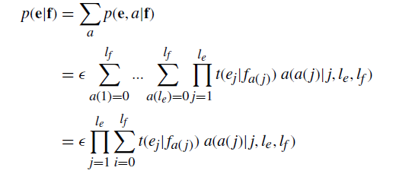
EM algorithm for parameter estimation
Expectation-Step

Slide 13
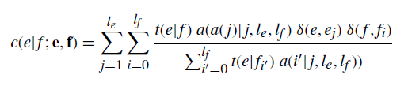
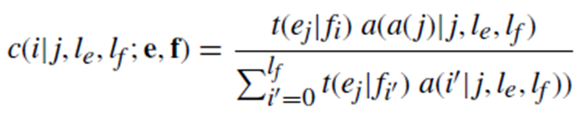
EM algorithm for parameter estimation
Maximization-step
The algorithm for training Model 2 is very similar to that for IBM Model 1.

Slide 14
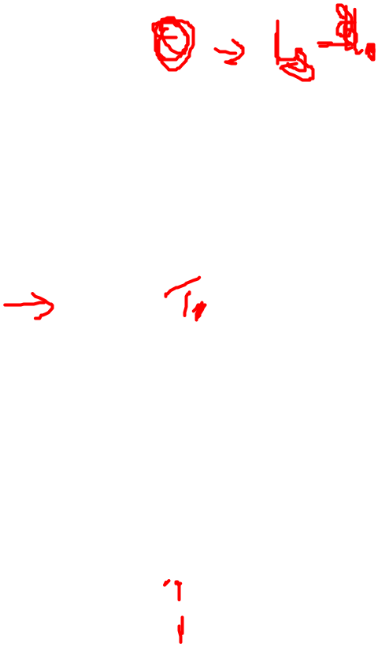
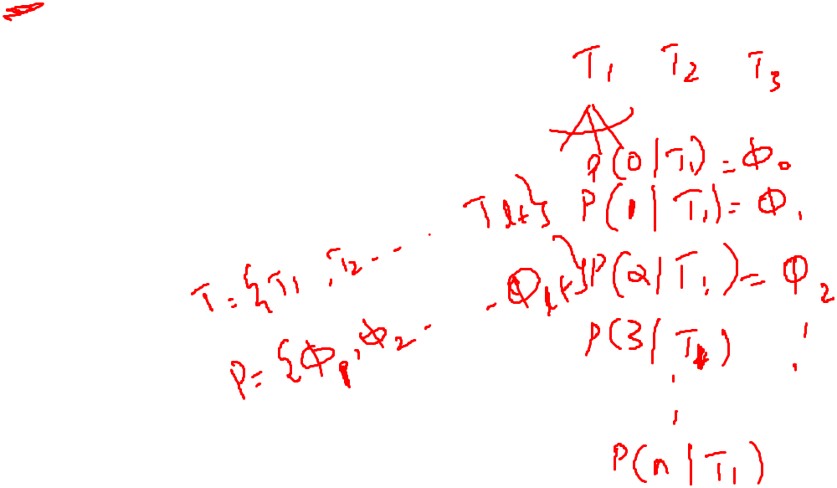
IBM Model 3
Features:
  fertility: # of words per foreign word
  NULL word generation
  distortion

Slide 15
IBM Model 3
We have not explicitly modeled how many words are generated from each input word.
In most cases, a foreign word translates to one single English word.
However, some foreign words like काम करने के लिए typically translate to two English words, i.e., to work.
Others, may get dropped.

Slide 16
IBM Model 3
We now want to model the fertility of input words directly with a probability distribution n(φ| f )
For each foreign word f , this probability distribution indicates how many φ = 0, 1, 2, ... output words it usually translates to.
n(1|घर) ~ 1
n(2| खुला होना) ~ 1
n(0|f1) ~ 1 // foreign word f1 that gets dropped

Slide 17
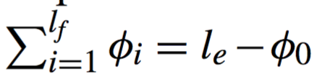
IBM Model 3
fertility of input words:
  n(φ|f) = a probability
  φ = 0, 1, 2, ... output words
Note:
  Fertility deals explicitly with dropping input words by allowing φ = 0.
φ_{i} = number of words generated by f_{i}
assume f₀ (NULL)
Each input word fi generates φi output words according to the distribution n(φi| fi).

Slide 18
IBM Model 3
The number of inserted NULL tokens φ0 depends on the number of output words generated by the input words.
Each generated word may insert a NULL token.

Slide 19
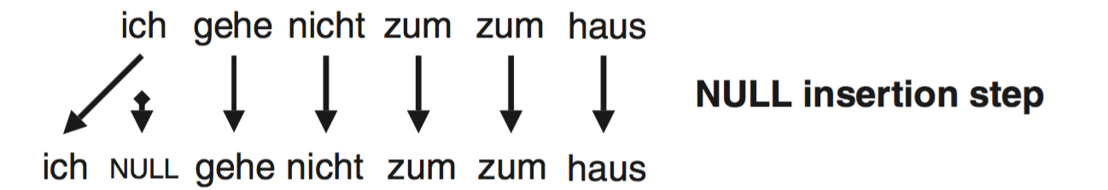
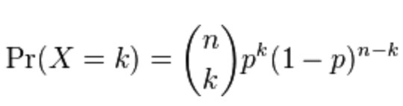


IBM Model 3
Null Generation (Insertion) step (fs → fs):
  # of inserted words clearly depends on the sentence length.
  After the fertility step, introduce one NULL token with probability p₁ after each generated word, or none with probability p₀=1−p₁.
  Let φ₀ be the # of NULLs generated.
  By the Binomial Distribution B(# generated words;p₀):

Slide 20
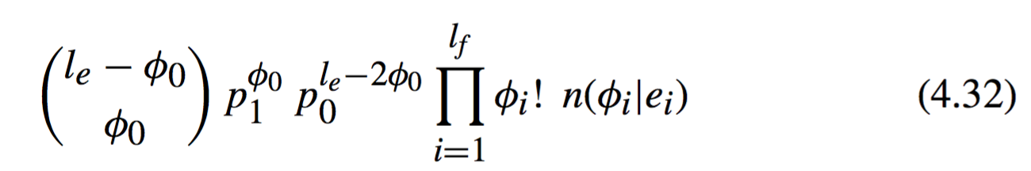

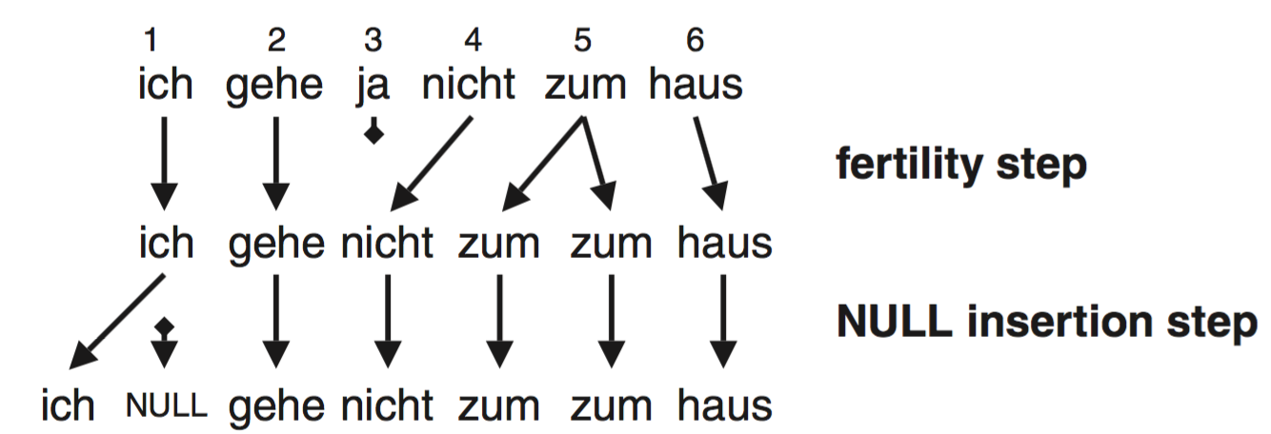

IBM Model 3
Fertility + NULL insertion:
TTTTTTTTT

Slide 21
IBM Model 3
TTTTTTTTT
Multiple ways (𝜙_{i}!):
  2! f → ^{f}_{f} →→^{e2}_{e1} or f →^{f}_{f} × ^{e2}_{e1}
  3! e₁ e₂ e₃ from f_{i} f_{i} f_{i} (f_{i} fertility 3) in 6 ways

Slide 22
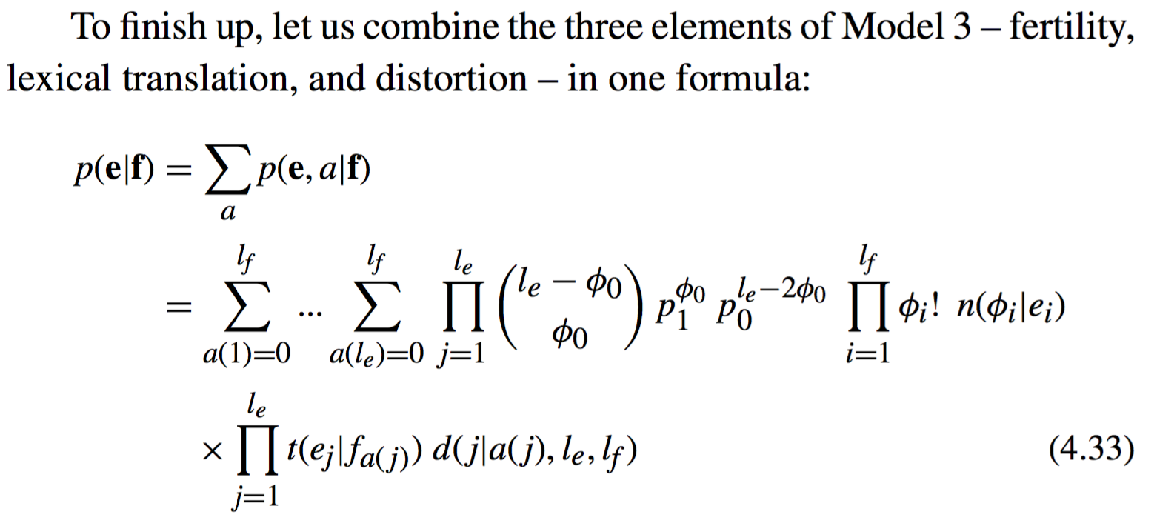

IBM Model 3
Null insertion
fertility
TTTTTTTTT
lexical translation
distortion

Slide 23
IBM Models 1-5 summary
IBM Model 1: lexical translation
IBM Model 2: alignment model
IBM Model 3: fertility
IBM Model 4: relative alignment model
IBM Model 5: deficiency.

